Slide 1
Unit 2.1 Identifying and Selecting Systems Development Projects
Introduction; Identifying and Selecting Systems Development Projects (The Process of Identifying and Selecting IS Development Projects, Deliverables and Outcomes); Corporate and Information Systems Planning

Slide 2
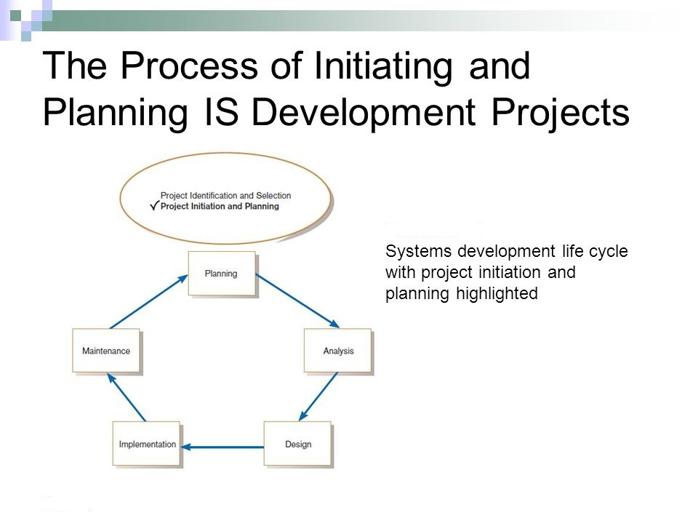

Slide 3
The Process of Identifying and Selecting IS Development Projects
Project identification and selection consists of three primary activities:
Identifying potential development projects
Classifying and ranking IS development projects
Selecting IS development projects

Slide 4
Identifying potential development projects
Identifying potential development projects. Organizations vary as to how they identify projects. This process can be performed by
a key member of top management, either the CEO of a small- or mediumsized organization or a senior executive in a larger organization;
a steering committee, composed of a cross section of managers with an interest in systems;
user departments, in which either the head of the requesting unit or a committee from the requesting department decides which projects to submit (often you, as a systems analyst, will help users prepare such requests); or
the development group or a senior IS manager.

Slide 5
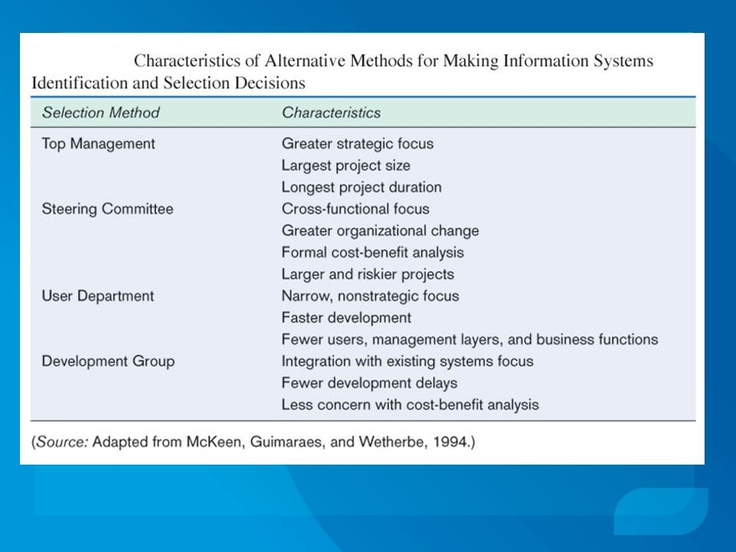

Slide 6
Classifying and ranking IS development projects
The second major activity in the project identification and selection process focuses on assessing the relative merit of potential projects. As with the project identification process, classifying and ranking projects can be performed by top managers, a steering committee, business units, or the IS development group. Additionally, the criteria used when assigning the relative merit of a given project can vary.

Slide 7
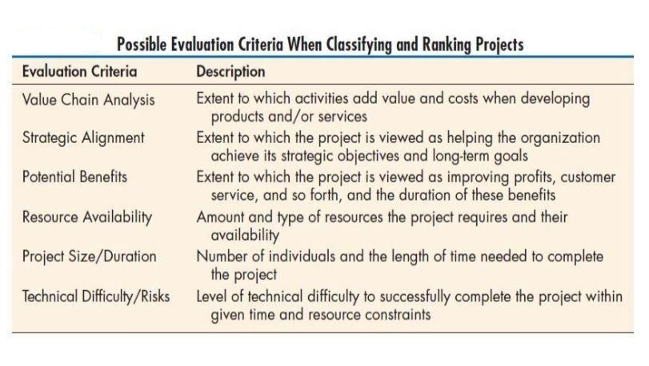

Slide 8
Selecting IS development projects
Selecting IS development projects. The final activity in the project identification and selection process is the actual selection of projects for further development. Project selection is a process of considering both short- and long-term projects and selecting those most likely to achieve business objectives. Additionally, as business conditions change over time, the relative importance of any single project may substantially change. Thus, the identification and selection of projects is a very important and ongoing activity.

Slide 9
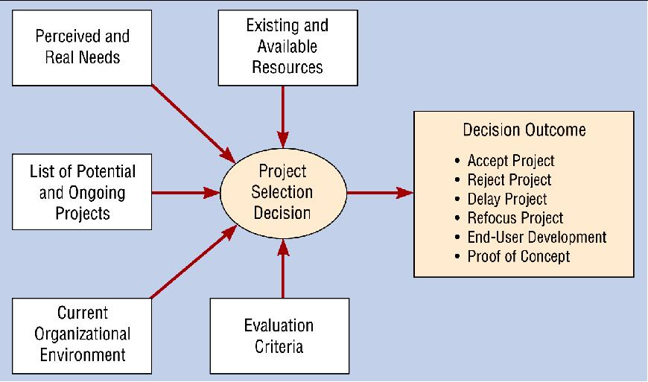

Slide 10
Deliverables and outcomes
The primary deliverable from the first part of the planning phase is a schedule of specific IS development projects, coming from both top-down and bottom-up sources, to move into the next part of the planning phase—project initiation and planning . An outcome of this phase is the assurance that careful consideration was given to project selection, with a clear understanding of how each project can help the organization reach its objectives. Due to the principle of incremental commitment, a selected project does not necessarily result in a working system. After each subsequent SDLC phase, you, other members of the project team, and organizational officials will reassess your project to determine whether the business conditions have changed or whether a more detailed understanding of a system’s costs, benefits, and risks would suggest that the project is not as worthy as previously thought.

Slide 11
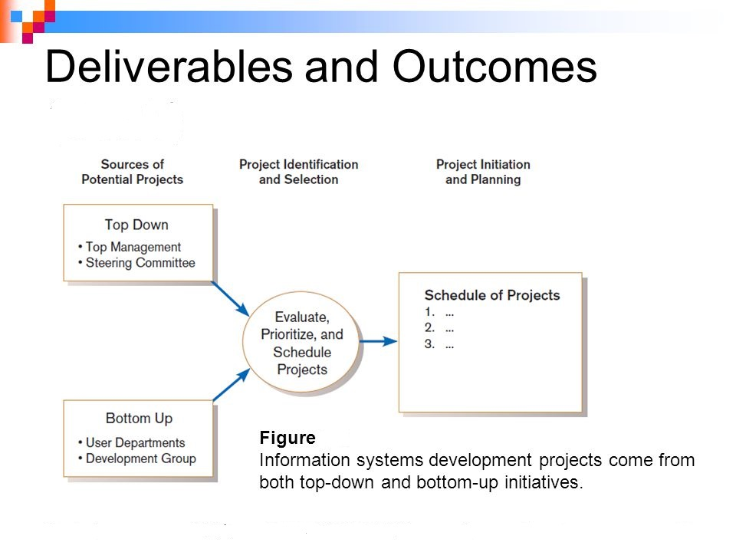

Slide 12
Corporate and Information Systems Planning
Organizations have not traditionally used a systematic planning process when determining how to allocate IS resources. Instead, projects have often resulted from attempts to solve isolated organizational problems. In effect, organizations have asked the question: “What procedure (application program) is required to solve this particular problem as it exists today?” The difficulty with this approach is that the required organizational procedures are likely to change over time as the environment changes. For example, a company may decide to change its method of billing customers or a university may change its procedure for registering students. When such changes occur, it is usually necessary to again modify existing information systems.

Slide 13
In contrast, planning-based approaches essentially ask the question: “What information (or data) requirements will satisfy the decision-making needs or business processes of the enterprise today and well into the future?”
A major advantage of this approach is that an organization’s informational needs are less likely to change (or will change more slowly) than its business processes. For example, unless an organization fundamentally changes its business, its underlying data structures may remain reasonably stable for more than 10 years. However, the procedures used to access and process the data may change many times during that period. Thus, the challenge of most organizations is to design comprehensive information models containing data that are relatively independent from the languages and programs used to access, create, and update them.
The need for improved information systems project identification and selection is seen when we consider factors such as the following:

Slide 14
Corporate Strategic Planning
A prerequisite for making effective project selection decisions is to gain a clear idea of where an organization is, its vision of where it wants to be in the future, and how to make the transition to its desired future state.
The first step focuses on gaining an understanding of the current enterprise. In other words, if you don’t know where you are, it is impossible to tell where you are going.
Next, top management must determine where it wants the enterprise to be in the future.
Finally, after gaining an understanding of the current and future enterprise, a strategic plan can be developed to guide this transition.

Slide 15
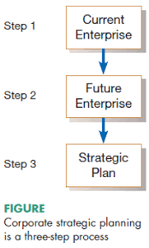

Slide 16
The process of developing and refining models of the current and future enterprise as well as a transition strategy is often referred to as corporate strategic planning. During corporate strategic planning, executives typically develop a mission statement, statements of future corporate objectives, and strategies designed to help the organization reach its objectives.
All successful organizations have a mission. The mission statement of a company typically states in very simple terms what business the company is in.

Slide 17
Information Systems Planning
The second planning process that can play a significant role in the quality of project identification and selection decisions is called information systems planning (ISP). ISP is an orderly means of assessing the information needs of an organization and defining the information systems, databases, and technologies that will best satisfy those needs. This means that during ISP you (or, more likely, senior IS managers responsible for the IS plan) must model current and future organization informational needs and develop strategies and project plans to migrate the current information systems and technologies to their desired future state. ISP is a top-down process.

Slide 18
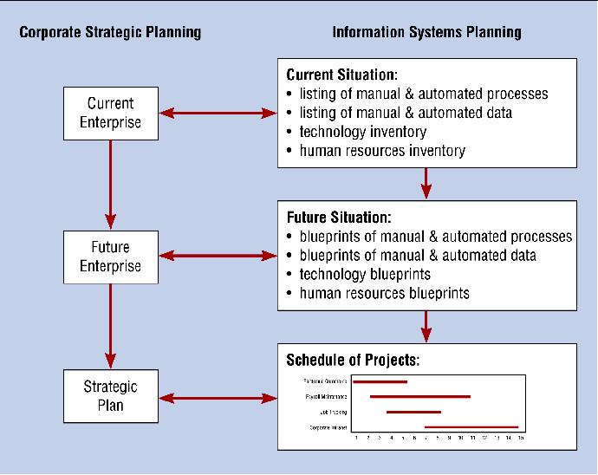

Slide 19
The three key activities of this modeling process are represented in Figure . Like corporate strategic planning, ISP is a three-step process in which the first step is to assess current IS-related assets—human resources, data, processes, and technologies.
Next, target blueprints of these resources are developed. These blueprints reflect the desired future state of resources needed by the organization to reach its objectives as defined during strategic planning. Finally, a series of scheduled projects is defined to help move the organization from its current to its future desired state. (Of course, scheduled projects from the ISP process are just one source for projects.
Others include bottom-up requests from managers and business units).

Slide 20
Describe the current situation
The most widely used approach for describing the current organizational situation is generically referred to as top-down planning. Top-down planning attempts to gain a broad understanding of the informational needs of the entire organization. The approach begins by conducting an extensive analysis of the organization’s mission, objectives, and strategy and determining the information requirements needed to meet each objective.
In contrast to the top-down planning approach, a bottom-up planning approach requires the identification of business problems and opportunities that are used to define projects. Using the bottom-up approach for creating IS plans can be faster and less costly than using the top-down approach; it also has the advantage of identifying pressing organizational problems.
Yet, the bottom-up approach often fails to view the informational needs of the entire organization. This can result in the creation of disparate information systems and databases that are redundant or not easily integrated without substantial rework.

Slide 21
Describing the target situation, trends, and constraints
After describing the current situation, the next step in the ISP (information system planning) process is to define the target situation that reflects the desired future state of the organization. This means that the target situation consists of the desired state of the locations, units, functions, processes, data, and IS.
For example, if a desired future state of the organization is to have several new branch offices or a new product line that requires several new employee positions, functions, processes, and data, then most lists and matrices will need to be updated to reflect this vision. The target situation must be developed in light of technology and business trends, in addition to organizational constraints (something which controls what you do by keeping you within particular limits ).

Slide 22
Developing a transition strategy and plans
Once the creation of the current and target situations is complete, a detailed transition strategy and plan are developed by the IS planning team. This plan should be very comprehensive, reflecting broad, long-range issues in addition to providing sufficient detail to guide all levels of management concerning what needs to be done, how, when, and by whom in the organization.
The IS plan is typically a very comprehensive document that looks at both short- and long-term organizational development needs. The short- and long-term developmental needs identified in the plan are typically expressed as a series of projects. Projects from the long-term plan tend to build a foundation for later projects (such as transforming databases from old technology into newer technology). Projects from the short-term plan consist of specific steps to fill the gap between current and desired systems or respond to dynamic business conditions. The top-down (or plan-driven) projects join a set of bottom-up or needs driven projects submitted as system service requests from managers to form the short-term systems development plan.

Slide 23
